Slide 1
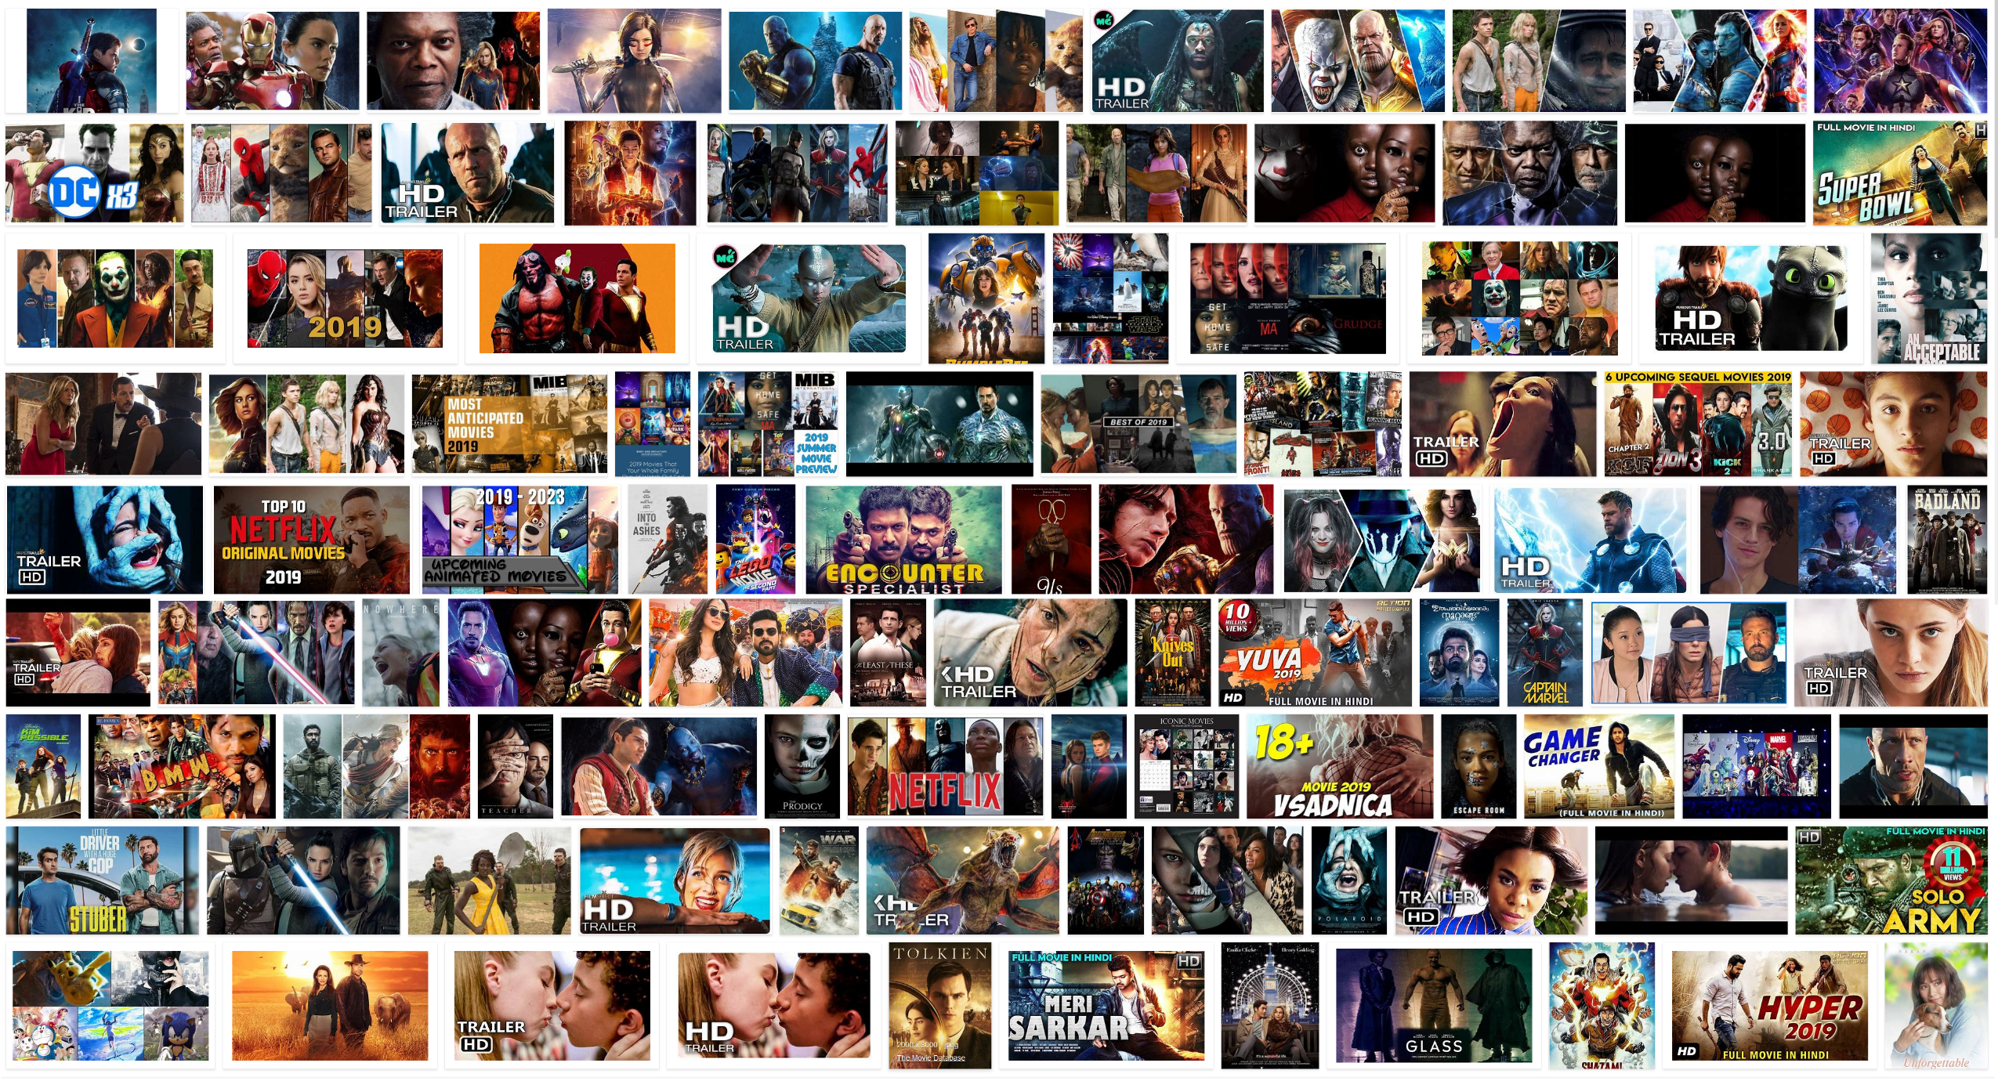
Sentiment Analysis
of movies utilizing lexicons and weighted engagement scores

Slide 2
MOTIVATION
Developing a way to quickly and accurately gather public sentiment on new movies.
Applications:
Allocating ad revenue
Recommender Systems
Reduce reliance on tele-research

Slide 3
GOAL
Develop AN ALGORITHM that accurately predicts public sentiment
PREDICTED MOVIE RATING
ROTTEN TOMATOES AUDIENCE SCORE

Slide 4
Sentiment: a measure of subjective opinion derived from text.
Project Components
Data mined using twitter’s API
Sentiment Analysis conducted using
Natural Language Toolkit
SentiwordNet lexicon

Slide 5
Evolution of Project
Migrated from using map reduce for sentiment analysis
Now using Python
Pandas Dataframes
Natural Language Toolkit
SentiwordNet Lexicon

Slide 6
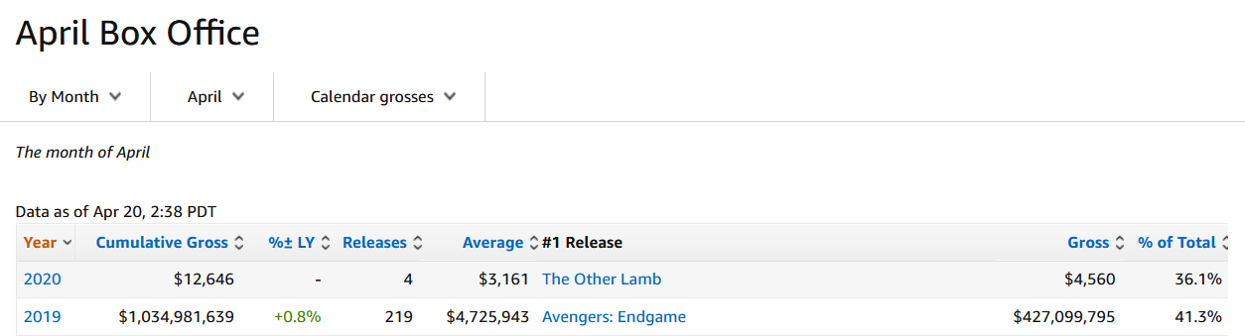
Evolution of Project
Switch from sentiment analysis of new releases.
Now focused of top STREAMING movies

Slide 7
Methodology

Slide 8
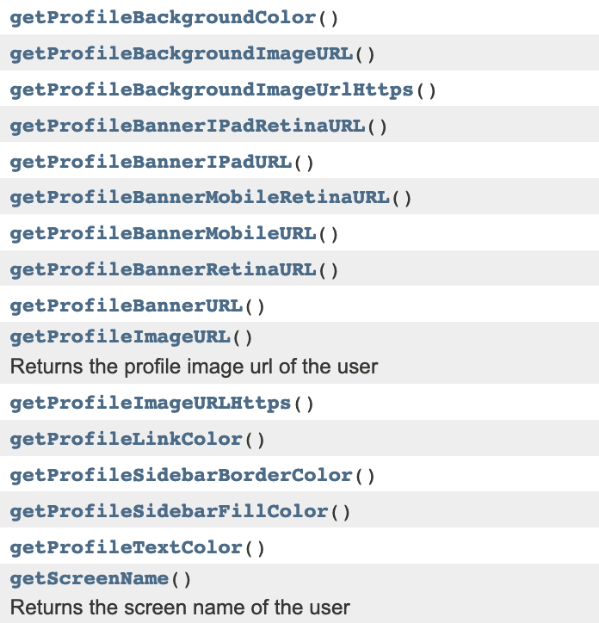
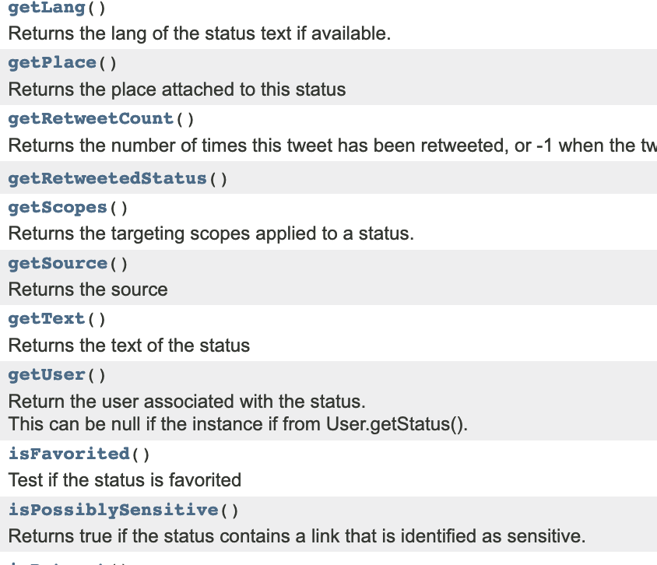
Data Mining: Using Twitter API to search for tweets about new films.
Library: Twitter4J: unofficial Java library for the twitter API
User data
Tweet data

Slide 9
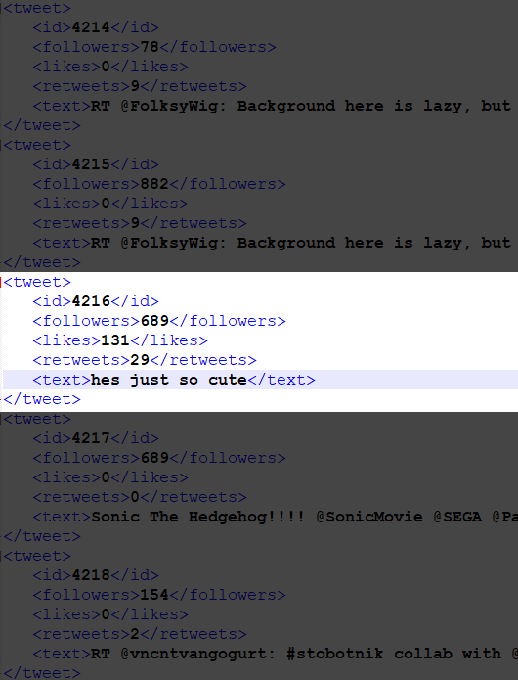
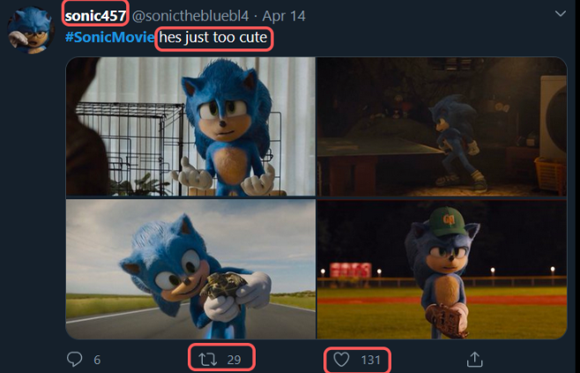
Methodology – Data mining

Slide 10
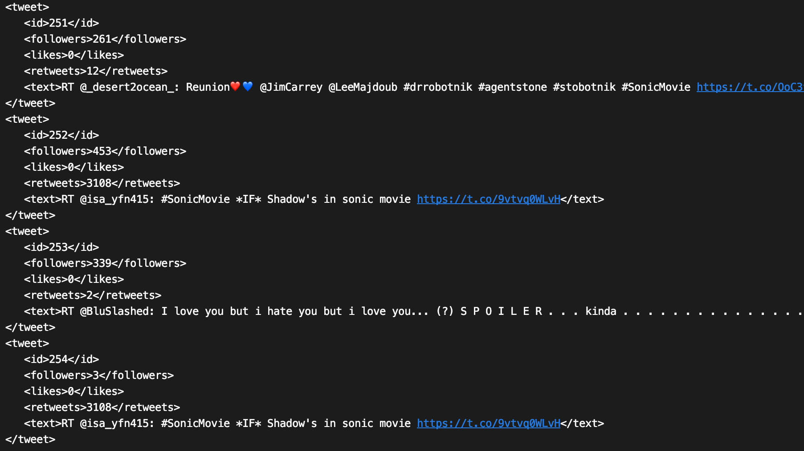

Slide 11
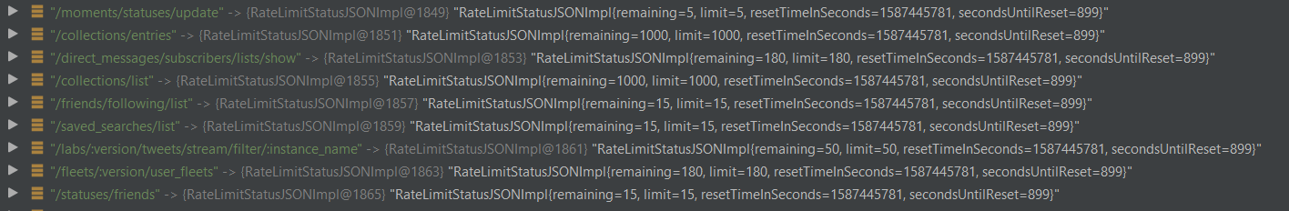
Data mining strategy
Twitter API Limitations
Mine tweets up to limit
Sleep until next 15 minute window
Repeat

Slide 12

Data mining strategy
Public Interest Limitations
Rotten Tomatoes score: 73%
My algorithm’s score: 0%
Documentary about Photographer Letizia Battaglia

Slide 13
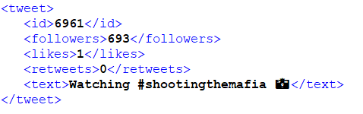
Data mining strategy
Public Interest Limitations
Cumulative data mined for Shooting the Mafia
New minimum threshold is 20 tweets

Slide 14

Data mining strategy
Term Selection
Rotten Tomatoes score: 20%
My algorithm’s score: 81%

Slide 15
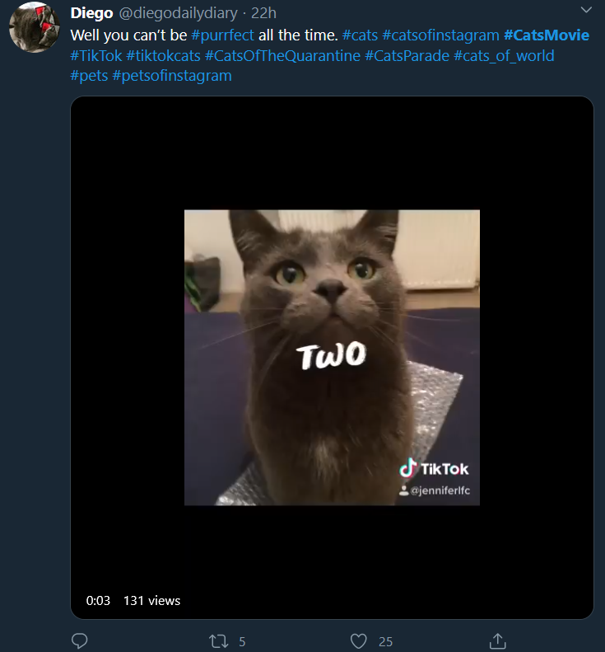
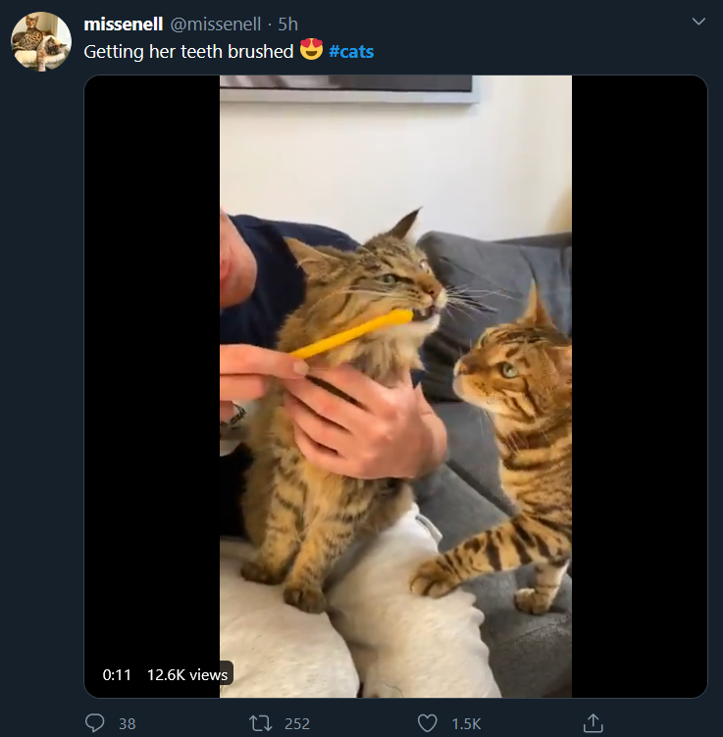
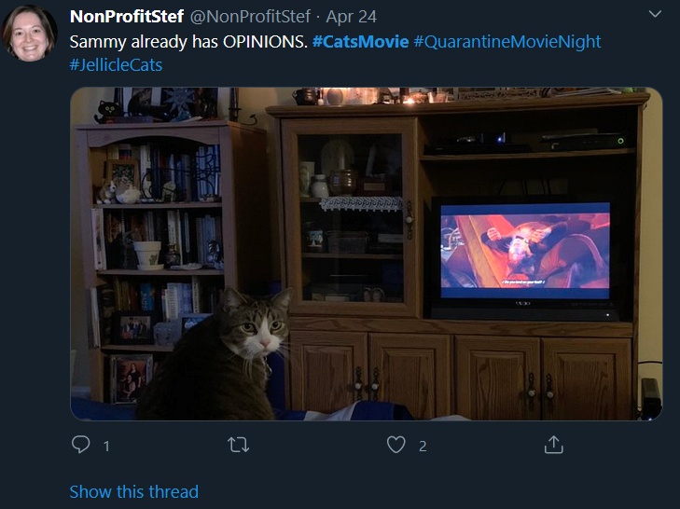
Data mining strategy
Term Selection
#catsmovie
#cats
#CatsMovie #JellicleCats

Slide 16
Methodology – Sentiment Analysis
WordNet
Developed by Princeton, WordNet is a large lexical database of English. Nouns, verbs, adjectives and adverbs are grouped into sets of cognitive synonyms (synsets), each expressing a distinct concept. Synsets are interlinked by means of conceptual-semantic and lexical relations.
SentiWordNet
SentiWordNet is a lexical resource for opinion mining. SentiWordNet assigns to each synset of WordNet three sentiment scores: positivity, negativity, objectivity.
Entry example
a 00228876 0.625 0 primo #1 the best of its kind
adjective
ID
Positive
score
Neg.
score
word
sense number
gloss

Slide 17
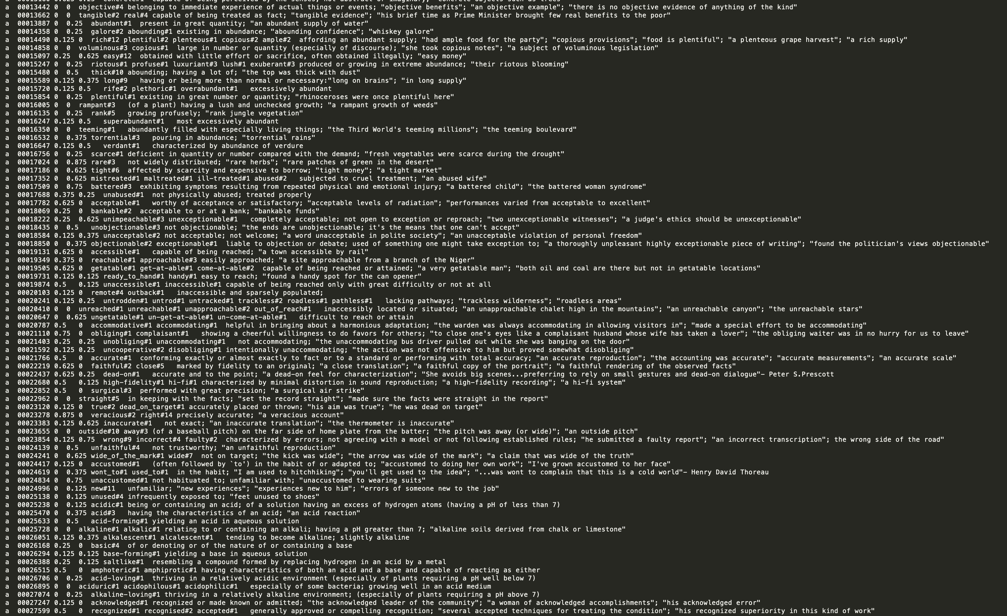

Slide 18
Methodology – Sentiment Analysis
Tweet Text
Cleaned up for analysis
Tokenization
simple tokens such as numbers, punctuation and words
Tagging (NLTK)
Role of each word
Convert to WordNet tags
Lemmatization
Remove inflectional endings (s, es, ing, ed, etc), return base form
Sum SentiwordNet Scores
Return Positive or Negative rating
WordNet Synsets
Notes:
Tokenization process: splits the text into very simple tokens such as numbers, punctuation and words of different types
Tagging: annotates the role of each word in the tweet
Lemmatization: remove inflectional endings only and to return the base or dictionary form of a word, which is known as the lemma

Slide 19
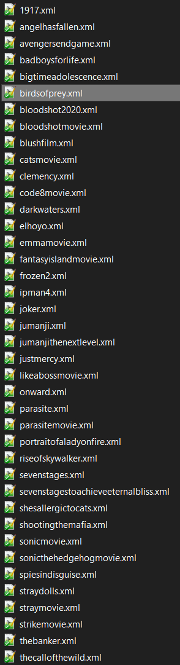
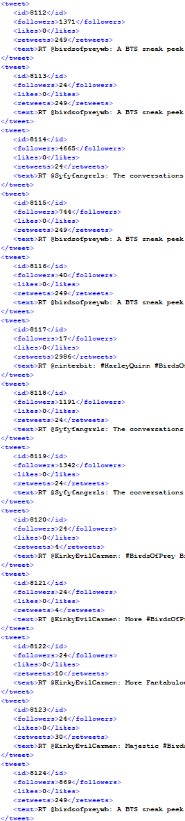
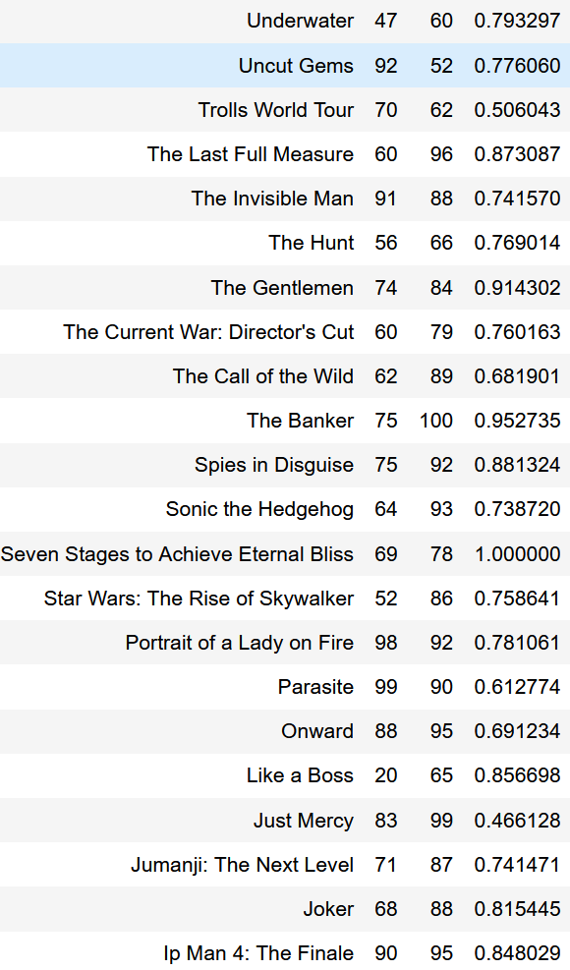
Files
Data
Scores
Final Calculation
Positive/Negative
Sentiment *
Followers
Likes
Retweets
Results

Slide 20
Results

Slide 21
RESULTS
Total Tweets Mined:
84,388
Average Tweets Per Movie:
2,219

Slide 22
RESULTS
User Engagement Score Findings
Likes, Retweets, and Follower Counts are meaningful only when taken together
Accuracy improved by setting minimum thresholds for all engagement scores
High follower count alone not significantly correlated with actual public sentiment

Slide 23
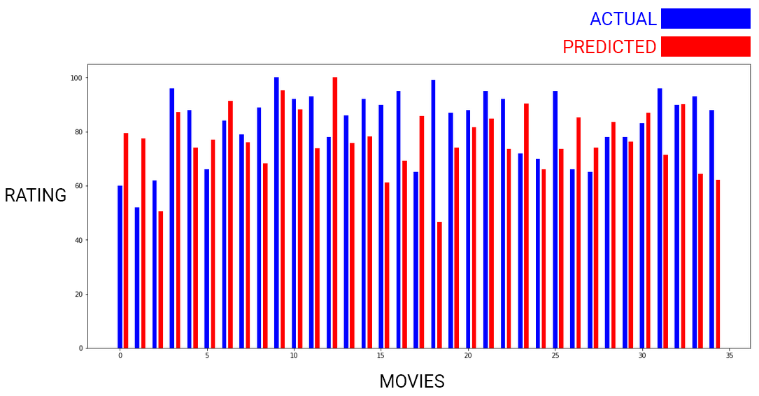
RESULTS
Predicting Rotten Tomatoes Audience Scores

Slide 24
RESULTS
PREDICTION ACCURACY
Percent Error: 17.26802006938638
Mean Absolute Error: 14.625840433155009

Slide 25
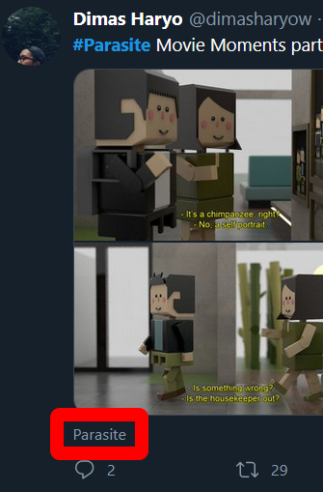
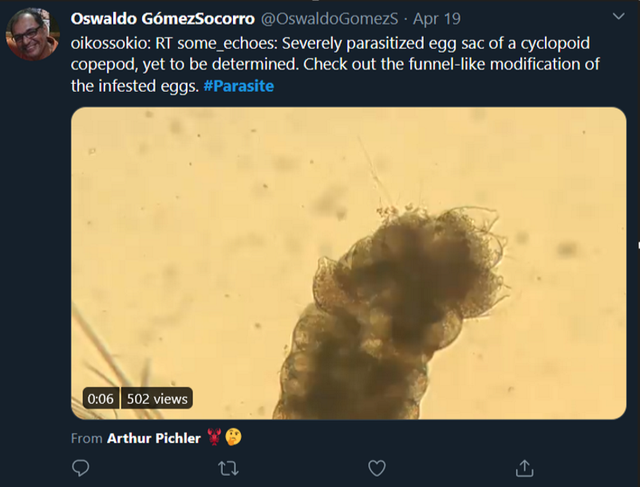
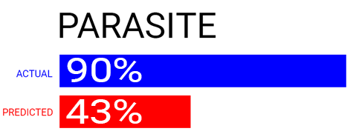
OUTLIER ANALYSIS
SentiwordNet Entry

Slide 26
Moving Forward – Address Opinion Spamming
Some users are obviously bots!
We’re not interested in their opinions!
Solutions
Spam detection
Eliminate duplicates
Explore twitter api metrics to validate users
(but not verified accounts sadly)

Slide 27
Thank you! Any Questions?

